Slide 1

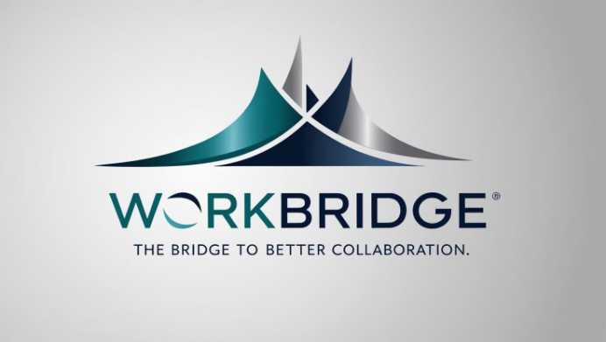
WorkBridge: Organizational Social Network
A unified workplace collaboration platform by Maor Sapo, Roy Har Zion, and Shai Yona.
WorkBridge simplifies communication and builds stronger communities.

Slide 2



What is WorkBridge?
Centralized Platform
WorkBridge simplifies organizational communication, collaboration, and community-building in one place.
Key Features
Organizational Feed for announcements
Private & Group Chats with history
Team Spaces for professional and social groups
Seamless Meeting Integration with Google Calendar and Zoom
It integrates existing tools, providing an intuitive, unified interface.

Slide 3



The Problem: Fragmented Communication
Scattered Tools
Consequences
WhatsApp for quick chats
Frequent platform switching
Slack or Email for teams
No single overview
Google Calendar & Zoom for meetings
Disconnected people and tasks
Google Drive for documents
Difficult onboarding
This fragmentation reduces efficiency and causes disconnect within organizations.

Slide 4
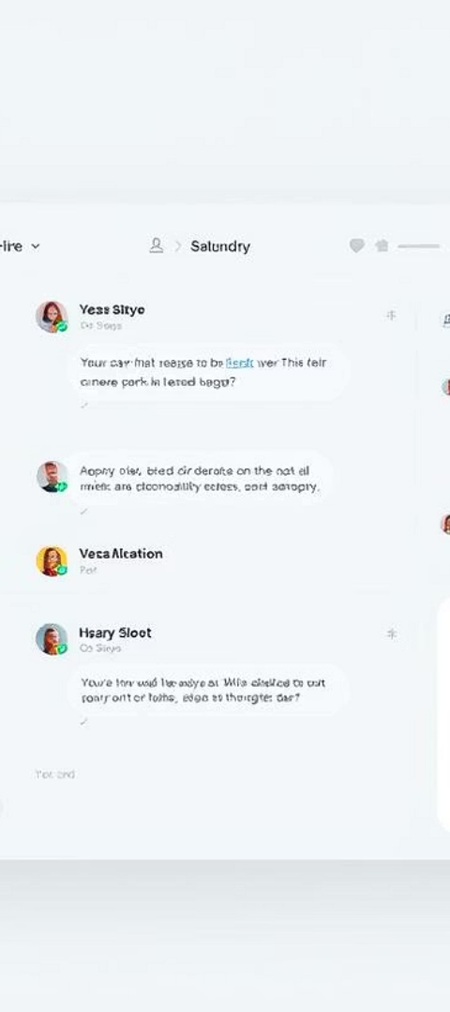




The Solution: WorkBridge Unification
Centralized Feed
Persistent Chat
See updates across teams and the whole organization.
Real-time chat with full message history.
Structured Groups
Integrated Tools
For departments, projects, or interest-based communities.
Calendar, Zoom, and shared resources all in one place.
WorkBridge delivers less distraction, better connection, and more clarity.

Slide 5
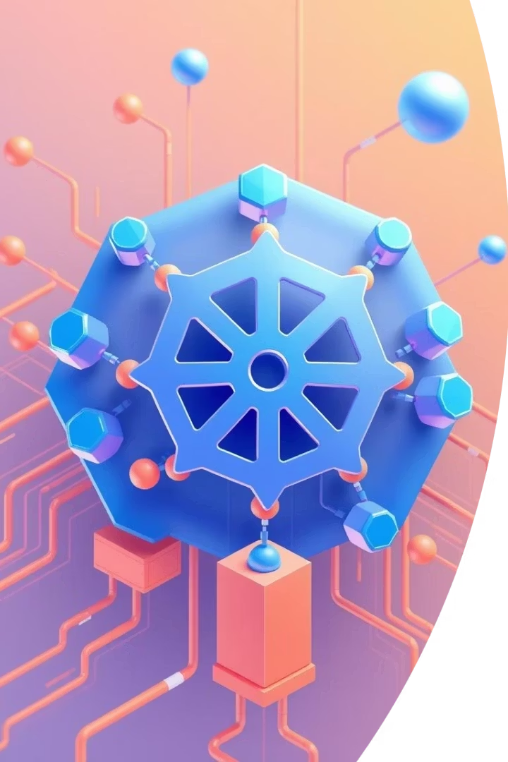




What is Kubernetes?
Scalability
High Availability
Automatic scaling as needed.
Multi-pod deployments with health checks.
Resource Management
Environment Management
Efficient allocation for optimal performance.
Secure, isolated environments.

Slide 6
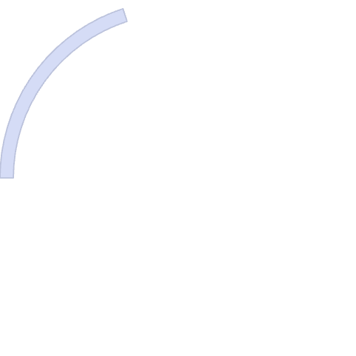









Kubernetes and WorkBridge Microservices
Chat
Authentication
Messaging functionality.
User identity and access.
Media
File sharing and uploads.
Database
Data persistence.
Frontend
User interface.
To manage these services, we containerized each one using Docker and with Kubernetes we are able to Deploy each service in its own pod, so they run independently.

Slide 7

Technologies
FastAPI (Python)
Speed and type safety
PostgreSQL
ACID transactions
SQLAlchemy ORM
Python objects vs SQL queries
JWT Authentication
Stateless and scalable
Docker
Service containerization
Kubernetes
Container orchestration

Slide 8
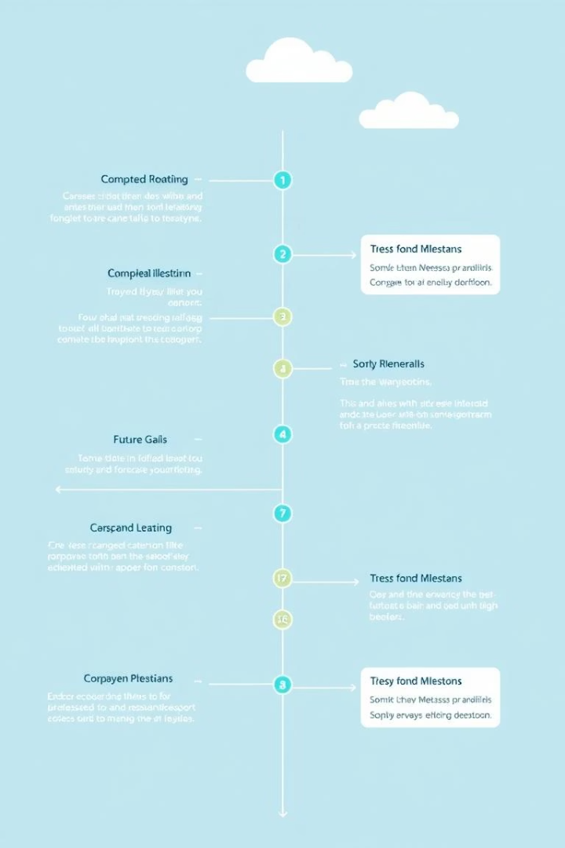
Project Status & Next Steps
1
What's Done
Auth flow end-to-end (FastAPI + React)
DB schema for users & chat
Basic React pages: login, dashboard, chat
Initial chat endpoint + UI
2
Must-Have (Before Final)
Full UI for messages & group management
Organizational Feed (backend + frontend)
Kubernetes deployment setup
Add real-time messaging support (WebSocket)
3
Nice-to-Have
File sharing per group
Offline read-only mode
We have a solid foundation and clear steps for completion and future enhancements.

Slide 9
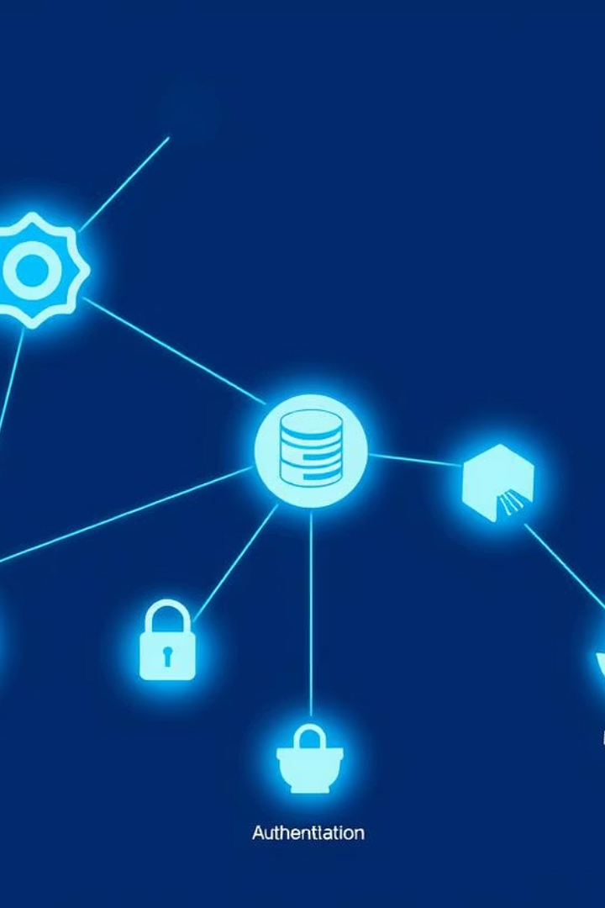
Demo

Slide 10




THANK YOU
Our Vision
User Experience
Technical Foundation
Unified workplace collaboration.
Intuitive and efficient design.
Built to scale reliably.
We aim to transform workplace interaction. Questions?

